Slide 1

ROCKBUSTER STEALTH L.L.C
ANALYSIS BY ISAAC OTUBANJO

Slide 2

TABLE OF CONTENTS
Introduction
Business Objective and Key Questions
Quick Facts
Detailed Analysis
Recommendations

Slide 3

INTRODUCTION
Rockbuster Stealth L.L.C is a movie rental company that used to have stores around the world. Facing stiff competition from streaming services such as Netflix and Amazon Prime, the Rockbuster Stealth management team is planning to use its existing movie licenses to launch an online video rental service to stay competitive.

Slide 4

BUSINESS OBJECTIVE
To obtain data-driven answers that can be used for the 2020 company strategy by answering key business questions.

Slide 5

KEY QUESTIONS
Which movies contributed the most / least to revenue gain?
What was the average rental duration for all videos?
Which countries are Rockbuster customers based in?
Where are customers with a high lifetime value based?
Do sales figures vary between geographic regions?

Slide 6

QUICK FACTS
The Rockbuster franchise has 599 customers in 109 countries. There are registered customer in 599 cities so far.
The company also has 2 staff based in 2 stores worldwide.
There are 1000 movie titles available in the Rockbuster database.
There are 4,581 copies of movies that are currently available for rental currently having generated $61,312 in revenue so far.
There has been 14,596 rentals in total.

Slide 7
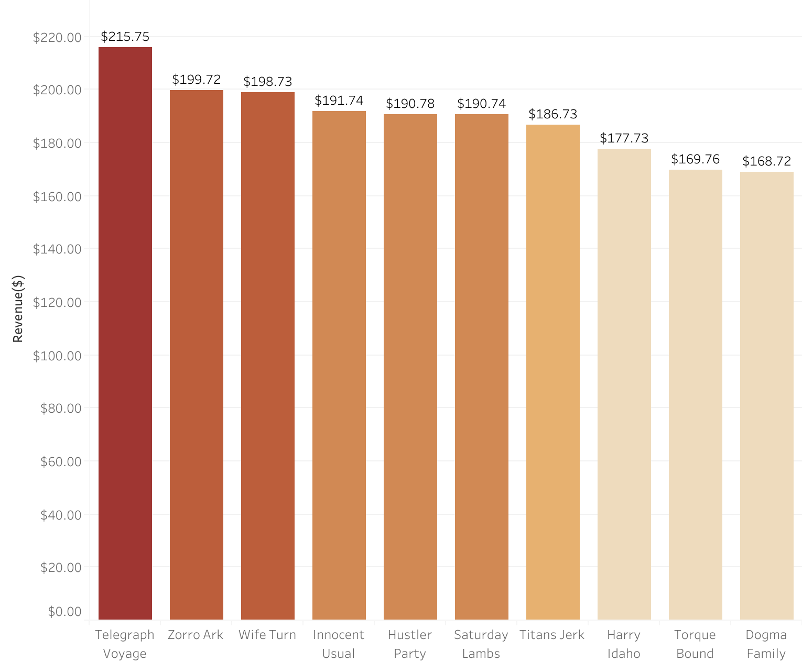
HIGHEST AND LOWEST GROSSING MOVIES
Telegraph Voyage is the highest grossing movie with a total value of $215.75 and it is closely followed by movies such as Zorro Ark, Wife Turn and Innocent Usual. Rockbuster could look to increase stock for these movies and potentially extend their licenses.

Slide 8
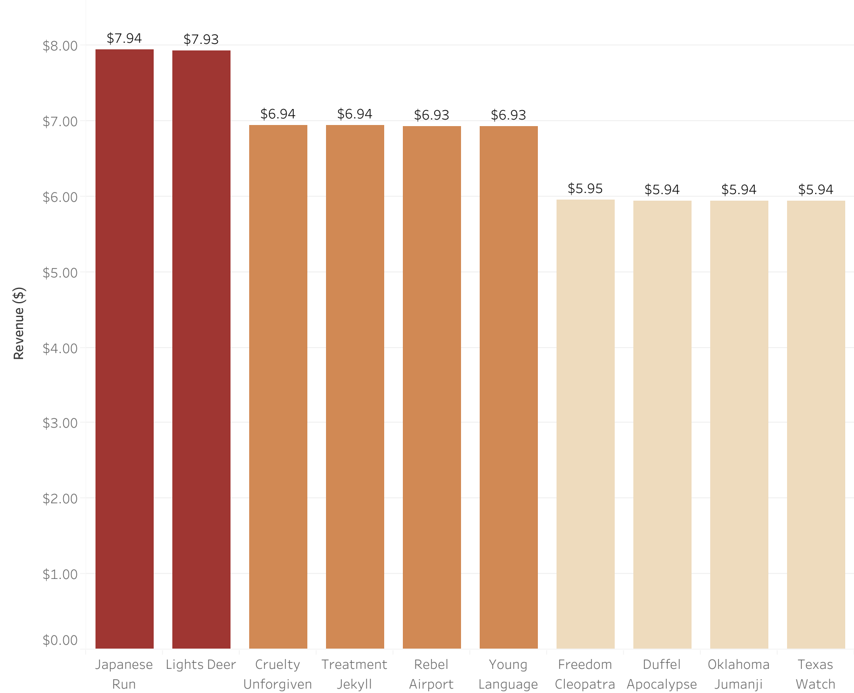
HIGHEST AND LOWEST GROSSING MOVIES
Texas Watch is the lowest grossing movie with a revenue of $5.94. It might be worth looking into discontinuing the rentals of movies such as this and canceling their licenses.

Slide 9



RENTAL AV ERAGES
At each rental rate, the total number of rental days are as follows: 0.99 for 349 days (average of 5 days), 2.99 for 323 days (average of 5 days) and 4.99 for 336 days (average of 5 days). This suggests that rental rates do not really affect the number of days customers rent / keep the movies.
The average replacement cost for replacing movies is $20.
The average rental rate for each movie is 3.
The average rental duration for all movies in the database is 5 days.

Slide 10
Movie Genre | Average Rental Duration (Days) | Minimum Rental Duration (Days) | Maximum Rental Duration (Days)
Thriller | 6 | 6 | 6
Travel | 5.5 | 3 | 7
Music | 5.2 | 3 | 7
Family | 5.15 | 3 | 7
Foreign | 5.12 | 3 | 7
New | 4.47 | 3 | 7
Documentary | 4.70 | 3 | 7
Games | 5 | 3 | 7
Children | 4.99 | 3 | 7
Classics | 4.92 | 3 | 7
Horror | 4.9 | 3 | 7
Action | 4.9 | 3 | 7
Sci-Fi | 4.76 | 3 | 7
Sports | 4.7 | 3 | 7
Documentary | 4.7 | 3 | 7
Drama | 5.05 | 3 | 7
Comedy | 4.82 | 3 | 7
Rental durations also offer an additional source of revenue as the customers must pay for the additional days; they keep the movies outside of the original agreement. So far, the overdue fees have generated about 24.3 % of the total earnings for Rockbuster (14,915 out of 61,312).

Slide 11
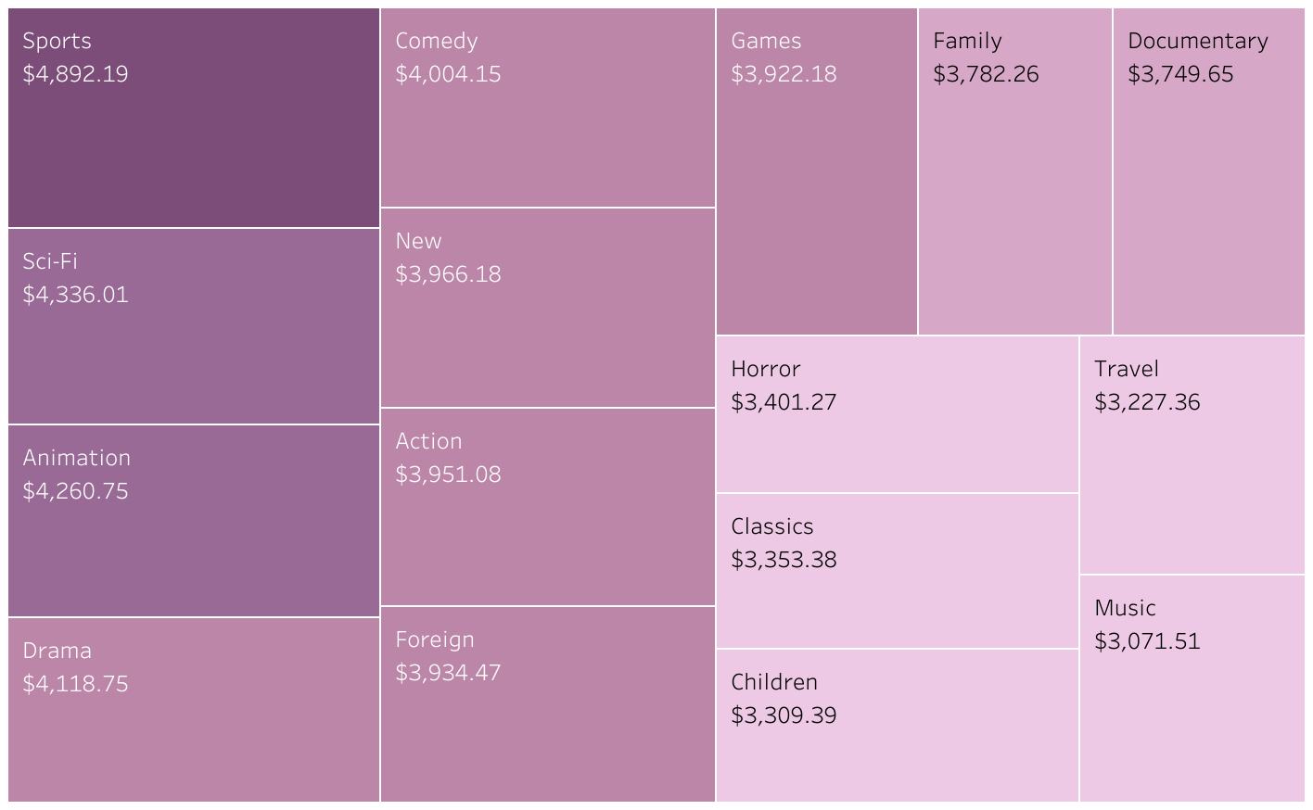
HIGHEST GROSSING MOVIE GENRES/CATEGORIES
The Sports, Sci-Fi and Animation Genres have grossed the highest in revenue.
Invest in acquiring more sports-related movies and optimize inventory levels for the Sports category.
Explore strategies to enhance customer engagement within categories in the mid-range level e.g., Comedy, Action and Foreign.

Slide 12
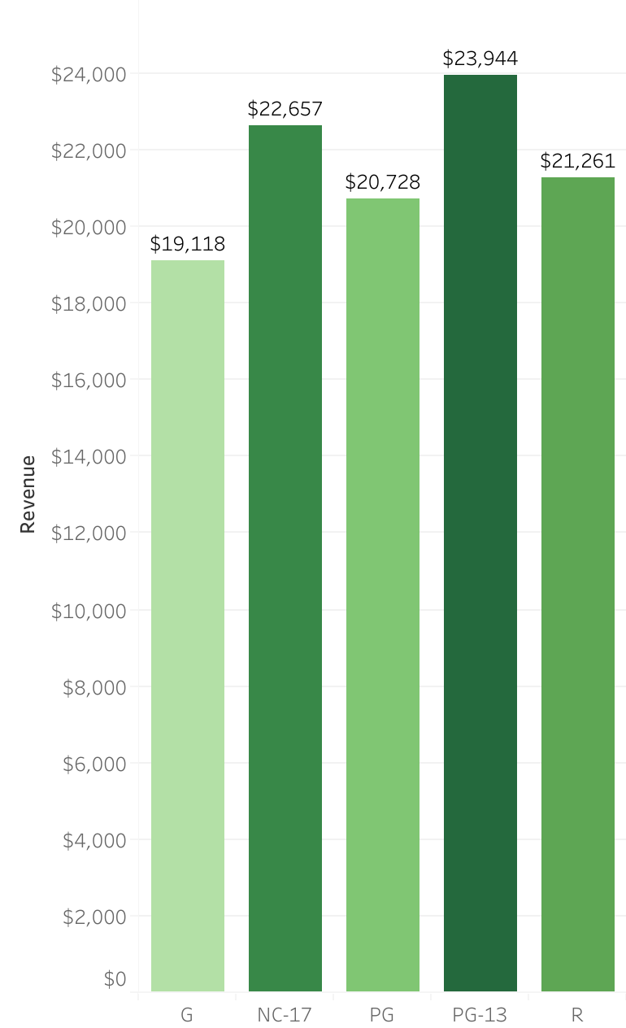
HIGHEST GROSSING MOVIES BY MPAA RATINGS
The PG-13 rated movies was the highest grossing MPAA rating in all the categories.
It might be worth looking into further acquiring licenses of movies in that category.

Slide 13
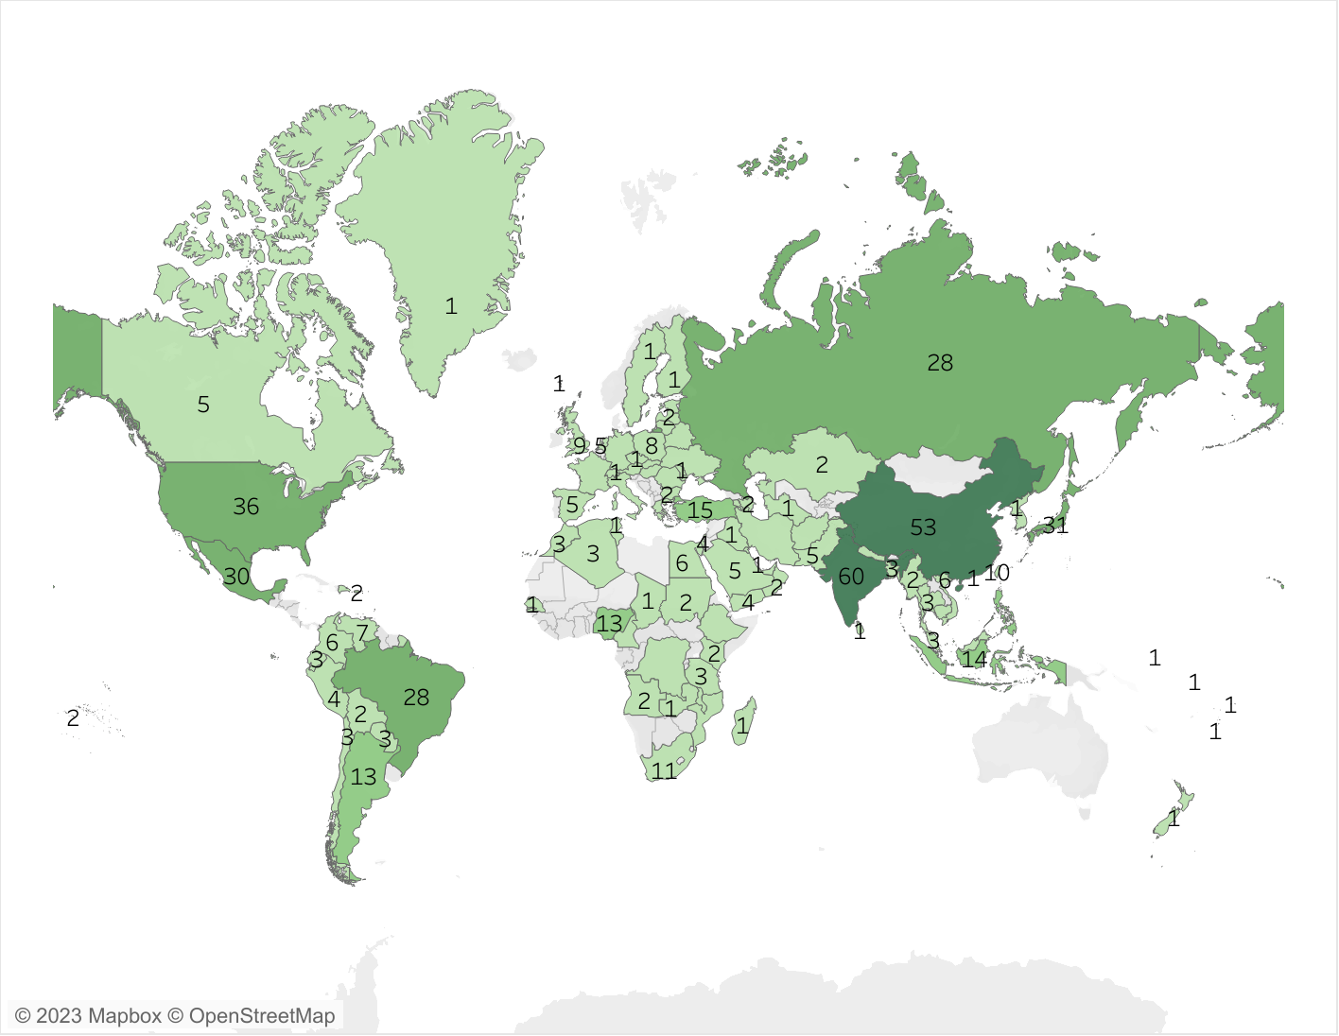

COUNTRIES WHERE CUSTOMERS ARE BASED
The company’s reach stretches far and wide thanks to the presence of at least 1 customer in 109 countries worldwide. Countries such as China and India have the highest customer counts with 53 and 60, respectively.

Slide 14
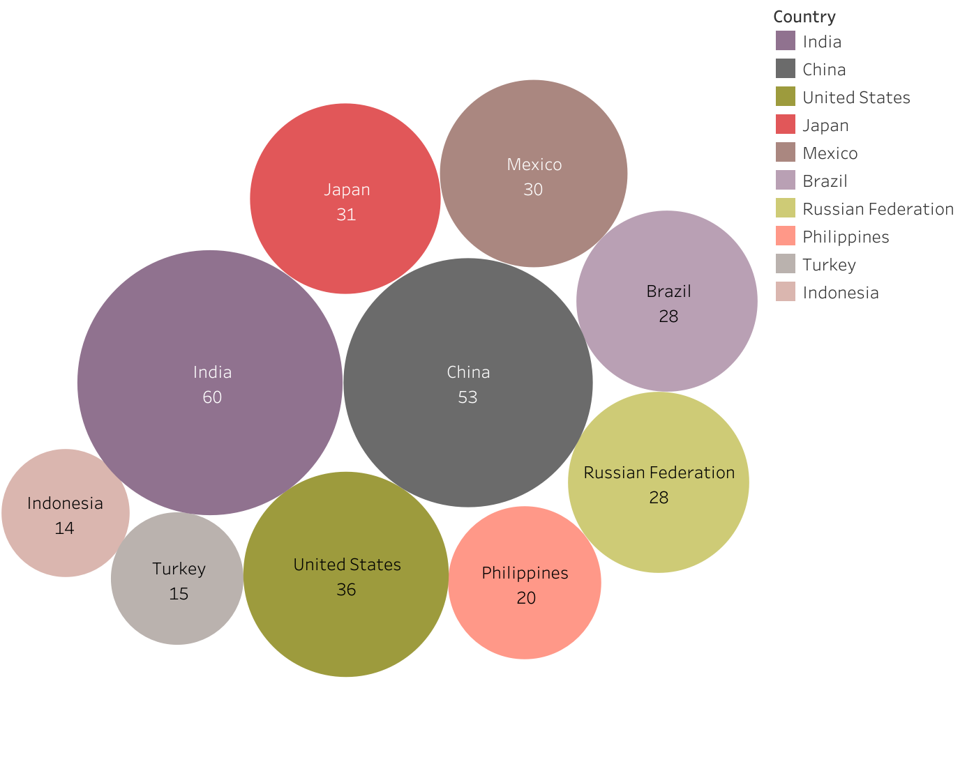
COUNTRIES WITH THE BIGGEST CUSTOMER BASE.
Of the 109 countries with at least 1 customer, the countries with the highest number of customers include India, China and United States.
Is there any correlation between the customer base and total revenue?

Slide 15
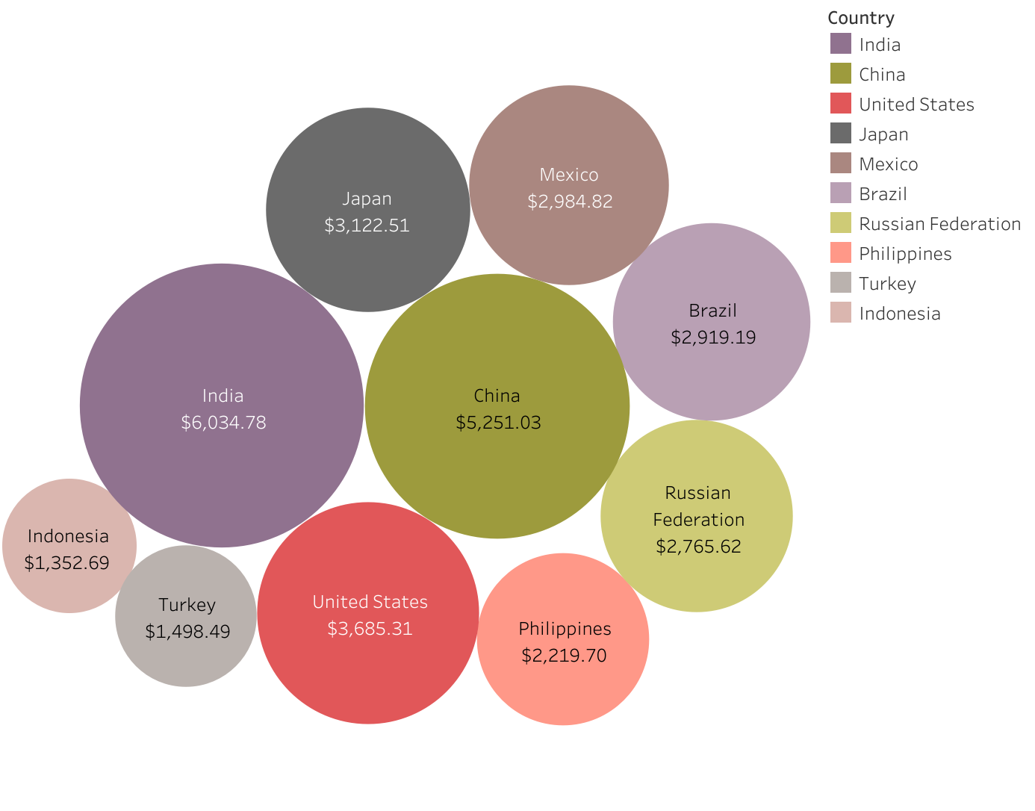
TOP 10 HIGHEST GROSSING COUNTRIES
Countries such as China, India and the United States have accrued the most in revenue over time. Rockbuster could look to expand the markets and improve advertising in these countries since they also have the highest number of customers.

Slide 16
CUSTOMERS WITH HIGH LIFETIME VALUE
Customer ID | First Name | Last Name | City | Country | Total Paid ($)
148 | Eleanor | Hunt | Saint-Denis | Russian Federation | 211.55
526 | Karl | Seal | Cape Coral | United States | 208.58
178 | Marion | Snyder | Santa Barbara dOeste | Brazil | 194.61
137 | Rhonda | Kennedy | Apeldoorn | Netherlands | 191.62
144 | Clara | Shaw | Molodetno | Belarus | 189.60
459 | Tommy | Collazo | Qomsheh | Iran | 183.63
181 | Ana | Bradley | Memphis | United States | 167.67
410 | Curtis | Irby | Richmond Hill | Canada | 167.62
236 | Marcia | Dean | Tanza | Philippines | 166.61
403 | Mike | Way | Valparai | Spain | 162.67
Company could look to offer loyalty incentives to these customers as part of a retention policy.

Slide 17
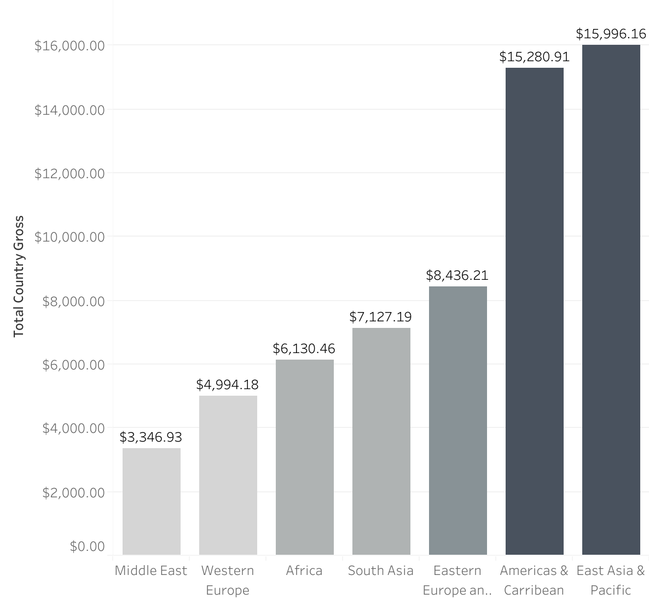
GROSS REVENUE BETWEEN GEOGRAPHIC REGIONS
The geographical region of East Asia & Pacific have had the highest revenue generated so far.
Rockbuster could look to launch the online startup in this region before expanding to others.

Slide 18

RECOMMENDATIONS
Relaunch efforts should be focused on regions with high revenue and high customer numbers. These regions include East Asia and Pacific, America and Caribbean, and Eastern Europe. Offer loyalty programmes and bonus incentives for high value customers. Invest promotional efforts and marketing resources in the top 3 countries by revenue and customer base – India, China and the United States. Increase investment in high grossing categories such as Sports, Sci-Fi and Animation. The company could look to launch their online video rental services with the biggest movies in these categories as they could potentially improve customer base. Review the lowest revenue performing countries and movies. Decide if they are worth investing in or completely cancelling and moving on to alternatives.

Slide 19

ISAAC OTUBANJO

